Slide 1
SupplyChainAI Challenge
Supply chain Operations Multi-Agent System
Presented by:
Deepak
Ritesh
Sumit

Slide 2
The Challenge
GlobalRetail operates 500 stores with 50,000 SKUs. Current siloed decision-making results in 15% stockouts ($8M/year) and 20% overstock ($15M tied capital). Build a multi-agent system for demand forecasting, inventory optimization, and logistics coordination with human approval for high-impact decisions.

Slide 3
Our Mission
Design and build an intelligent multi-agent system using LangChain and LangGraph. Your system must coordinate multiple specialized AI agents with appropriate human oversight for critical decisions

Slide 4
Solution – LangChain + LangGraph

Slide 5
Agents
Data Loader
Data Profiling
Features
Demand Forcast
Inventory Optimization
Supplier Procurement
Logistic Capacity
Human Review
Evaluation

Slide 6
Flow
Load Data
↓
Profile Data (clean, sort)
↓
Feature Engineering (add calculated columns)
↓
Demand Forecasting (LLM or statistical)
↓
Inventory Optimization (calculate safety stock & ROP)
↓
Supplier Procurement (check status, find alternatives)
↓
Logistics Capacity (plan shipments)
↓
Human Review (approve/modify/reject)
↓
[if approved] Evaluation (calculate metrics)
↓
END

Slide 7
Data Loader Agent & Data Profiling
Data Loader Agent
  We are using 6 months of data divided over different stores and SKUs
  If the data is not present then the data is excepted through cache which was loaded in the memory on the last run
Data Profiling
  We clean the data
    Select only required columns
    Sort the data
    Bring the data in the required state

Slide 8
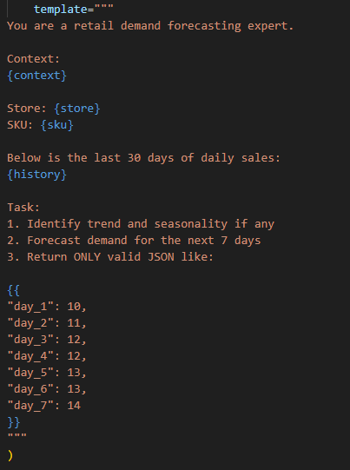
Demand Forecast
Helps in forecasting the demand based on the prompt , keeping the special occasions and weekends
  Where
    Context is Document with guides with
      Lead time, Alternate Suppliers, Black Friday
    SKUs and Store refer to the different stores
    History is the calculated average for every SKU
    Based on seasonality and demand pattern

Slide 9
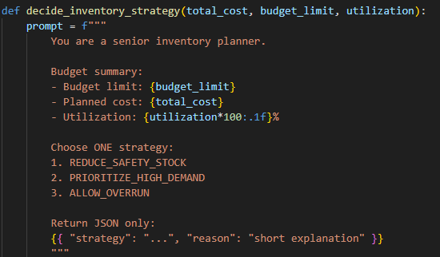
Inventory Optimization
  Decides how to take care of the inventory
    If the Inventory budget is in the budget then the flow executes without hampering
    If the Inventory Budget overflows then based on Budget , Cost, Utilization we ask the LLM to suggest the strategy to reduce the stock
    Based on which we return the Inventory plan , budget constrains and alerts if any

Slide 10
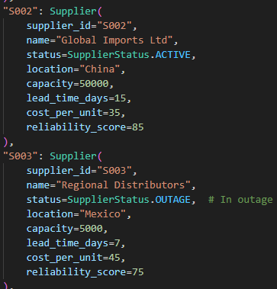
Supplier Procurement
  Detects supplier outages
  Process inventory requirements
  Check supplier availability and alternative sourcing
  Negotiate for emergency supply
  Predefine list of Supplier , which consist of there id , name and lead time ,location based on which we can decide which is the best option for procuring the SKUs

Slide 11
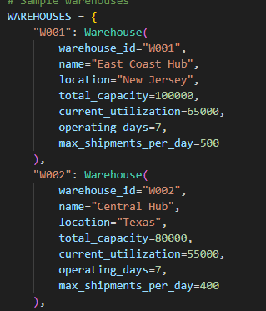
Logistic Capacity
  Display warehouse status
  Detect capacity constraints
  Plan shipment
  Black Friday Surge planning

Slide 12
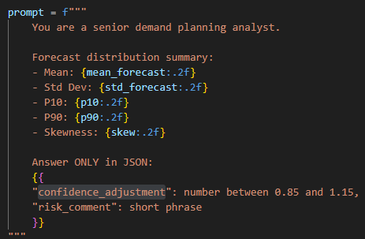
Human Review & Evaluation
Human Review
  Based on decision we return the data
    If approved then the entire data is returned
    If rejected then blank
Evaluation
  Based on mean , deviation, p90,p10,skew we
  create a prompt for llm for the the confidence

Slide 13
Thank you !!!

